Slide 1
My Voice Counts: SEND Youth Council
27 November 2024

Slide 2
We asked the “My Voice Counts” group what was important to them in these 4 areas:
Learning and working
Living and housing
Being healthy
Having fun

Slide 3
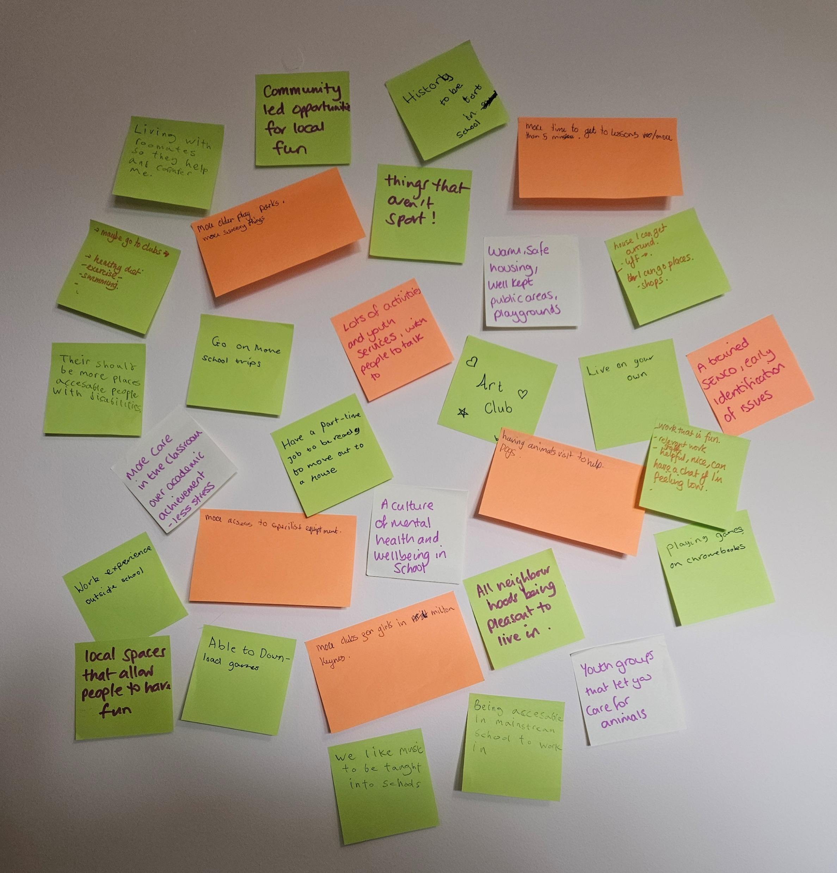
The next slides summarise what they told us.

Slide 4
Learning and working
Kind staff who we can talk to and who care about our wellbeing
The opportunity to learn things that we are interested in, like music and history
Reasonable expectations of us about things like how long it takes to get between lessons, and uniform
Staff who are well trained and can tell quickly if we are struggling
Schools which are accessible for our physical and sensory needs
Opportunities for more school trips and to spend time with animals
Work that is fun and we enjoy
Work experience outside of school
The opportunity to get a part time job

Slide 5
Living and housing
Access to specialist equipment and adaptations that I need so I can look after myself as much as possible
Choice about whether I live on my own or with mates
That I feel ready to move out of my childhood home
All neighbourhoods being nice and safe to live in
Housing that’s warm and safe

Slide 6
Being healthy
Healthy diet, and opportunities to exercise including swimming
More sensory support
People to talk to

Slide 7
Having fun
More choice of clubs/youth groups and activities we can go to that are fun and local – not just sports!
More play parks for older children and that are accessible to people with disabilities
Playgrounds and spaces to hang out in that are well kept and feel safe
Maybe some opportunity to have fun that involves animals, art and playing computer games
Being able to go to places, like shops

Slide 8
We will use this information to help us decide what our priorities should be for 2025 - 2028

