Slide 1
How to prepare your child with Special Educational Needs to successfully start a new ‘Secondary school’
By: Specialist Teaching Team and SENDIAS Service
Monday 20th May – MS Teams

Slide 2
Housekeeping
Please keep your mic muted
You do not need to have your camera on
For further individual support:
SENDsupport@milton-keynes.gov.uk

Slide 3
By end of this session
Practical strategies to ensure smooth transition
Things to consider
What to expect now till start of the school year
Where to find help

Slide 4
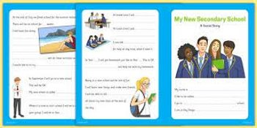
What school might do
Possible introduction to teacher
Social Story ​
One page profile
​
Visits
Transition days
Summer School
Transition meeting
Might ask for paperwork
School visit
Information transfer
Is your school doing something different, which you have found useful?
Make most of the Transition Day – don’t be afraid to ask questions

Slide 5
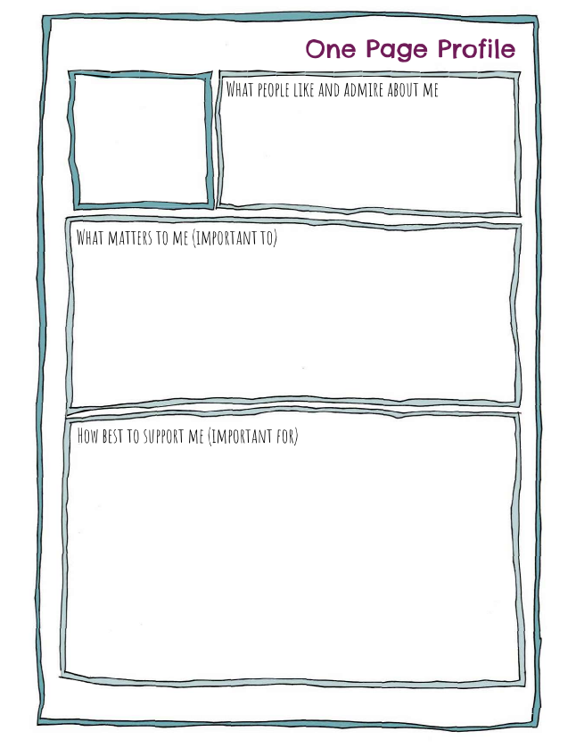
Sharing Information
One Page Profile
SEND Support Plan
Healthcare Plan (not EHCP)
Top tips for a successful One Page Profile - Special Needs Jungle​​
One page profile: video & template - NDTi​​

Slide 6
How to prepare your child
Plan ahead
Communication with school
Practical preparation

Slide 7
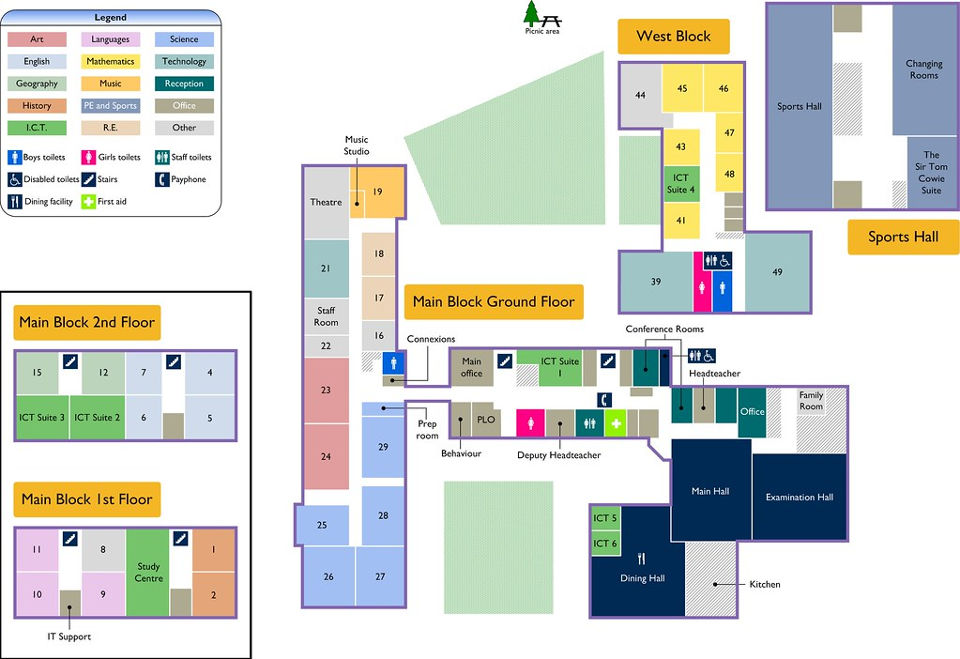
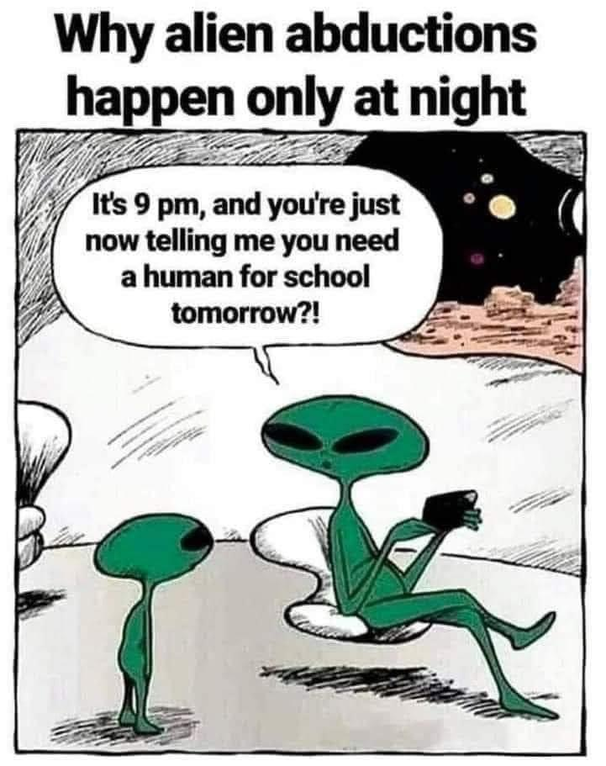
Practical preparation
Familiarise with timetable - try colour coding it or take a photo/mobile
Checklist for things they need in school bag
Map navigating to places; map out the route
Link with new friends ​

Slide 8
Practical preparation
Uniform- practice dressing; tie knots; consider sensory needs and check uniform policy
Good routine – breakfast and sleep
School Lunches
Ask about reasonable adjustments linked to sensory/physical

Slide 9
Linking with the school
Read the SEND Policy, Mobile phones use, Behaviour, Social Media Policies, Uniform
Find out about the timetables/routines , or expectations to help prepare your child ​
Ask about what support may be offered ​
Ask who is your main contact and the best way to get updates ​
Use the school website- find out about daily school routines eg: home work, lunch menus, time table

Slide 10
Expectations
Reasonable adjustments
How to stay in touch with staff
What will support look like?
Supporting behaviour
Homework

Slide 11
Friendships
How to support your child to make friends
Link with other parents to organise get togethers
Practice friendship skills such as listening, sharing, compromising, and negotiating
Help them to gain confidence – to practice social skills
Reassure them that it’s natural for friends to fall out sometimes
Help children to think of questions they can use to make connections with friends, such as:
Asking questions about shared interest or hobbies - would you like to play football during break?
Social Scripts
Tips and Advice about Friendships - guide for young people by YoungMinds
Notes:
Top tips: 5 ways to support your child to make friends | Children's Mental Health Week (childrensmentalhealthweek.org.uk)
Young minds Friends | Tips and Advice about Friendships | YoungMinds
First day nerves – how to prepare First day nerves – how to prepare, keep calm and carry on - BBC Bitesize

Slide 12
Social Emotional and Mental Health
What works for your child/YP?
After school routines
Strengths and interests
How your child/YP can ask for help
Changes in behaviour- share concerns with school
Bedtime routines

Slide 13
Michael Green
Youth Mental Health and Youth Outreach Worker
Mind BLMK
Tips on how to support and prepare your child for new school

Slide 14
And finally...
Change can be difficult- you may need to give time for your child to settle
Keep yourself calm
Give school the chance to get to know your child

Slide 15
Milton Keynes Local Offer
W: www.mksendlocaloffer.co.uk ​
: www.facebook.com/MKSEND

Slide 16
MK SENDIAS Service
Independent - Impartial - Confidential
IAS – Information, Advice & Support
Statutory Service
Remit - Education, Health and Social Care
(as defined by the SEND CoP)
Impartiality
Sits in the SEND legal framework
Work at arm’s length from the Local Authority
Not connected to schools
T: 01908 254518
E: contact@mksendias.org.uk
W: www.mksendias.org.uk
www.facebook.com/MKSENDIAS
Self Referral: https://mksendias.org.uk/referral

Slide 17
Helpful resources….
Support in school - MK Local Offer
How can I help my child with SEND prepare for school? - MK Local Offer
Milton Keynes Libraries: Check ‘Parent shelf’ or search ‘Starting schools’ in e-catalogue.
Starting or switching school - NAS​​
Workshops by Contact - Secondary school age
Sleep:
Children with SEND - The Sleep Charity
Helping your child to sleep - Scope UK
Moving up! The transition to secondary school - Animation and Resources - Anna Freud
How Parents Can Help With Secondary School Transition – YoungMinds
10 tips for parents to help their children cope with change - YoungMinds
Five ways to help autistic students get settled - Tes Magazine
5 ways to support your child to make friends - Children's Mental Health Week
Find Your Feet: Parent webinar how you can support your child through the change from primary to secondary school
Lots of good tips here but not specifically SEN: Starting secondary school - BBC Bitesize
My moving up to secondary school booklet – Compass
First day nerves – how to prepare, keep calm and carry on - BBC Bitesize
Newsround Videos
5 Tips for Starting Secondary School
Back to School: Top Tips for Starting Secondary School
Information and factsheet - MK SENDIAS

Slide 18
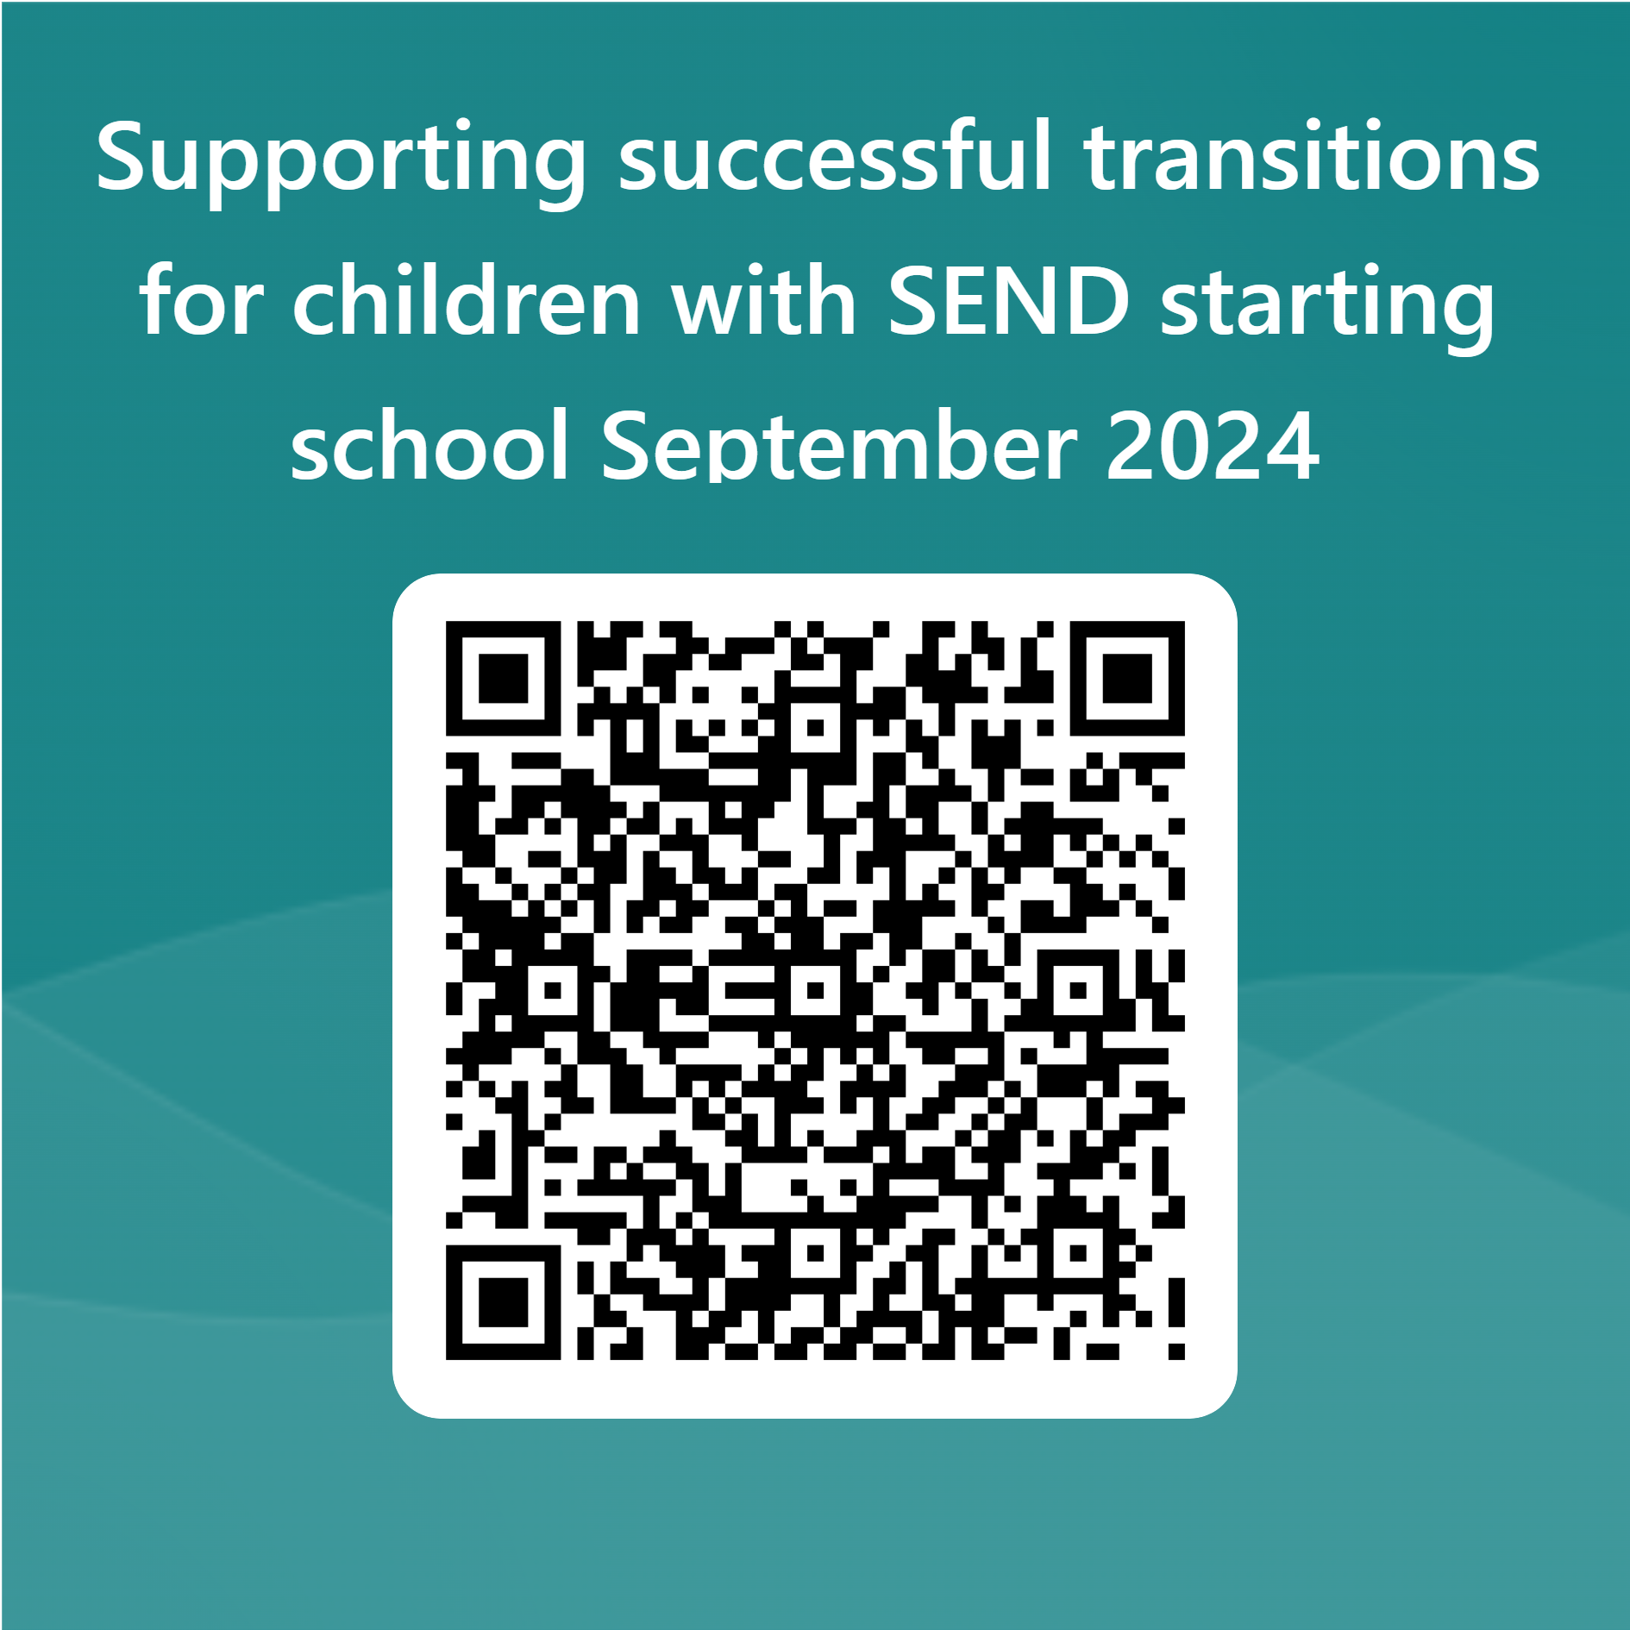
Thank You

