Slide 1
How to prepare your child with Special Educational Needs to successfully start primary school
By: Specialist Teaching Team and SENDIAS Service
Monday 13th May 1.00- 2.00pm

Slide 2
By end of this session
Practical strategies to ensure smooth transition
Things to consider
What to expect now until start of the school year
Where to find help
Able to ask questions ?

Slide 3
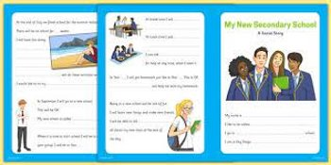
What school might do
Possible introduction to teacher
Social Story ​
One page profile
​
Visits
Transition days
Picnic
Stay and play
Transition meeting
Might ask for paperwork
Home visits/ setting visit
Information transfer
Is your school doing something different, which you have found useful?

Slide 4
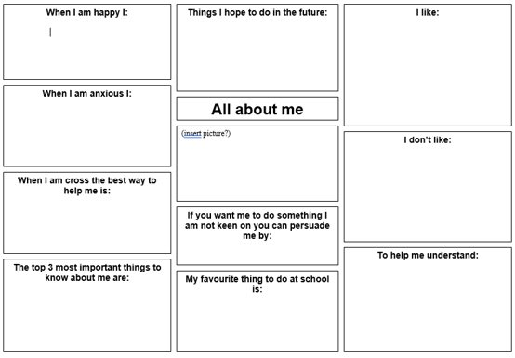
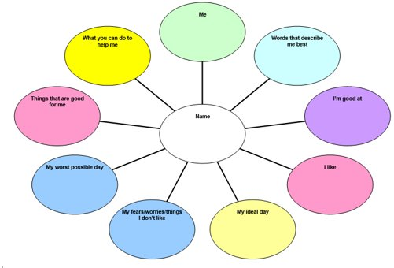
Sharing Information
All About Me
One Page Profile
SALT passport
SEND Support Plan
Healthcare Plan (not EHCP)
One page profile: video & template - NDTi​​
Top tips for a successful One Page Profile - Special Needs Jungle​​

Slide 5
How to prepare your child
Plan ahead
Communication with school
Practical preparation

Slide 6
Practical preparation
Uniform- practice dressing; consider sensory needs
PE Kit and changing
Practise opening packets; lunchboxes etc , school dinners - using cutlery
Ask about reasonable adjustments linked to sensory/physical
Emotional regulation

Slide 7
Linking with the school
Read the SEND Policy; Behaviour,
Find out about the timetables/routines, or expectations to help prepare your child ​
Ask about what support may be offered ​
Ask who is your main contact and the best way to get updates ​
Use the school website- find out about daily school routines eg: lunchtime, breaktimes, etc

Slide 8
Expectations
Hours- full/part time; staggered start
How to stay in touch with staff
What will support look like?
Toileting
Supporting behaviour

Slide 9
Social Emotional and Mental Health
What works for your child/YP?
After school routines
Strengths and interests
How your child/YP can ask for help
Changes in behaviour- share concerns with school
Bedtime routines

Slide 10
Friendships
How to support your child to make friends
Link with other parents eg: play dates for younger children
Help them to gain confidence – look at developing play skills , sharing and taking turns
Reassure them that it’s natural for friends to fall out sometimes
Notes:
Top tips: 5 ways to support your child to make friends | Children's Mental Health Week (childrensmentalhealthweek.org.uk)
Young minds Friends | Tips and Advice about Friendships | YoungMinds

Slide 11
Remember ….
Change can be difficult- you may need to give time for your child to settle
Keep yourself calm
Give school the chance to get to know your child

Slide 12
Who can support
Talk to your setting SENCO
Talk to your child’s class teacher
Arrange a meeting with the school SENCO
Feel confident to ask school any questions

Slide 13
Milton Keynes Local Offer
W: www.mksendlocaloffer.co.uk ​
: www.facebook.com/MKSEND

Slide 14
MK SENDIAS Service
Independent - Impartial - Confidential
IAS – Information, Advice & Support
Statutory Service
Remit - Education, Health and Social Care
(as defined by the SEND CoP)
Impartiality
Sits in the SEND legal framework
Work at arm’s length from the Local Authority
Not connected to schools
T: 01908 254518
E: contact@mksendias.org.uk
W: www.mksendias.org.uk
www.facebook.com/MKSENDIAS
Self Referral: https://mksendias.org.uk/referral

Slide 15
Helpful resources….
Support in school - MK Local Offer
How can I help my child with SEND prepare for school? - MK Local Offer
Ideas, strategies and resources to help children and young people with SEND.
Milton Keynes Children and Young People's Occupational Therapy Team
Advice sheets - over 5 years
Sensory Difficulties
Milton Keynes Libraries: Check ‘Parent shelf’ or search ‘Starting schools’ in e-catalogue. Books on potty training also available.
Starting School: A Peter Rabbit Tale by Beatrix Potter
Starting or switching school - NAS​​
Potty training children with additional needs – ERIC
Starting school and toileting - NHS
Workshops by Contact on topics such as ‘managing your child’s sleep’, ’toilet training’
Sleep:
Children with SEND - The Sleep Charity
Helping your child to sleep - Scope UK
Starting primary school - Family Lives
Five ways to help autistic students get settled - Tes Magazine
5 ways to support your child to make friends - Children's Mental Health Week
Information and factsheet - MK SENDIAS

