Slide 1
Supporting Children and Young People with Glue Ear
Sensory Team

Slide 2
What Is ‘Glue Ear’?
Glue ear is where the middle part of the ear canal fills up with fluid. This can cause temporary hearing loss.
Glue ear is usually a temporary and fluctuating condition which usually clears up on its own, but parent/carers are advised to see a GP.

Slide 3
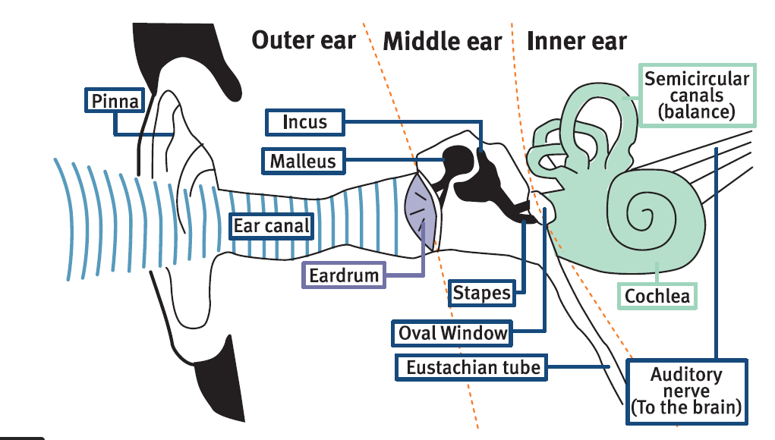
What Is ‘Glue Ear’?
https://www.nhs.uk/Video/Pages/Glueearanimation.aspx
Please watch the video at the bottom of this link as it explains in detail what glue ear is, what causes it and how it's treated
The middle ear is filled with fluid rather than air

Slide 4
Signs Of ‘Glue Ear’
There may be many signs of Glue Ear, these may include:
speaking loudly
being difficult to understand
asking people to repeat what they say
asking for the TV or music to be turned up loud
struggling to hear people far away
becoming easily distracted when people are talking
finding it hard to concentrate or seeming tired and irritable because it's harder for them to listen
not engaging / distant in activities/tasks/group discussions
copying peers
watching speaker intently
finds loud sounds disturbing

Slide 5
Impact Of Glue Ear
Glue ear may result in the following:
Cause physical symptoms – one or both ears may feel uncomfortable / sore, may affect balance
Affect listening
Affect speech and language development
Affect social and emotional development
Be aware Glue Ear can fluctuate. Check in particular, the child who has a cold or seems distracted. Say their name and smile.

Slide 6
What to do?
With parental consent, refer to the School Nurse or GP/HV for referral
Ask family to take child to GP or Health visitor
GP/Health Visitor may suggest a watch and wait for 3 months
Exceptions for quick referral: smelly ear, children in higher risk groups eg Downs Syndrome or a cleft palate.
Family may request referral to Paediatric Audiology through GP
Management options - ENT referral for consideration of grommets or hearing aids .

Slide 7
What To Do Whilst Waiting?
Adapting the environment
Adapting your communication
Providing activities to support: - Listening - Language
- Social and emotional development

Slide 8
Adapting The Environment
Be aware of poor acoustics and their impact:
Reduce background noise where possible; for example
use table coverings, carpets and soft furnishings to reduce reverberation
reduce extraneous noise; close doors/windows to outside areas whilst noisy activities are happening outside; choose when you have music playing – not constantly in the background
Use visual aids and props to maintain focus and use supporting vocabulary
Be aware of light source in class
Use favourable seating (front and facing speaker)

Slide 9
Adapting Your Communication
Establish listening rules
Get the child’s attention before you start speaking by using their name
Make sure the child can see your face, make eye contact and smile
Speak clearly, with normal intonation and rhythm - don’t shout
Start with simple language relating to what they are doing
Use short sentences or chunks of language that are supported with pictures or objects
Begin with what they have said and expand on it. Repeat when necessary
If using more complex language always give examples and context to support understanding
Check understanding using open-ended questions

Slide 10
Providing Activities To Support: Listening, Language and Social and Emotional Development
Listening: - use of games which require a pupil to follow instructions, for example, barrier games
- check using open-ended questions
Language: - use multi-sensory activities and visual aids to support language - Build on what the child says and add information
Social and Emotional Development: - Organise, monitor and manage group activities - Support and model checking methods so the child can inform others when they haven’t heard some thing - provide visual aids to explain their emotions

Slide 11
Further Information
Further information and resources can be found:
www.ndcs.org.uk/information-and-support/childhood-deafness/causes-of-deafness/glue-ear/?gclid=CjwKCAiA3aeqBhBzEiwAxFiOBqxz6DeKOtChlXhZByXl9g-B1Pgmb2C8UUV3fJavLG46XoTX3mDn2hoCzOEQAvD_BwE#
Free National Deaf Children’s Society (NDCS) training course for professionals
www.ndcs.org.uk/our-services/services-for-professionals/training-courses/e-learning/introduction-to-temporary-hearing-loss-cpd-accredited/
www.GlueEarTogether.org.uk - Free resource ‘Hearing to Succeed and Achieve’

Slide 12
Further Information
https://youtu.be/56agaiGhAuw

Slide 13
Treatment For Glue Ear
Treatment for glue ear is considered by a GP
Glue ear is not always treated. The GP may wait to see if the symptoms get better on their own.
This is because there's no effective medicine for glue ear, and it often clears up on its own.
The child may be monitored for up to a year in case their symptoms change or get worse.
The GP may suggest trying a treatment called autoinflation while waiting for symptoms to improve. Autoinflation can help fluid in the ear to drain. Discuss autoinflation with GP/HV/School Nurse
The 2 main treatments are grommets (small tubes implanted in the ear) or temporary hearing aids.
Occasionally, surgery may be recommended to remove some glands at the back of the nose (adenoids). This is known as an adenoidectomy.
The specialist in hospital will decide on the best treatment option.

Slide 14
Some Useful Terms
Grommets
Grommets are small plastic tubes which sit in a hole in the eardrum, and let air get in and out of the ear. Grommets are sometimes also called ventilation tubes.
Hearing loss
Normal hearing is when the quietest sound a person can hear in either ear is anywhere between 0 dB to 20 dB. Hearing loss is defined as when a person cannot hear sounds until they are above that 20 dB threshold in one or both ears. The louder a sound needs to be in dB before they can hear it, the greater their level of hearing loss (for example, someone who can only hear sounds of 50 dB or more has greater hearing loss than someone who can hear sounds of 25 dB or more).
Hearing tests
This can be any suitable test to assess hearing, but should always be age and developmentally appropriate for the person, and use properly calibrated equipment.

Slide 15
Need Further Information
Contact Details
Uday Thakrar (Head of Sensory Team) Uday.Thakrar@Milton-Keynes.Gov.UK Tel: 01908 669735 ext 147

